Slide 1


Introduction to hacking
Madhav Shah

Slide 2

Agenda
What is hacking ?
Types of hackers
The reason behind hacking
How to protect yourself from getting hacked ?
Madhav Shah

Slide 3

What is Hacking ?
•
Hacking refers to activities that seek to compromise digital devices, such as computers, smart phones, tablets, and even entire networks.
•
An example of computer hacking can be: Using a password cracking algorithm to gain access to a computer system.
•
Hackers may be motivated by a multitude of reasons, such as profit, protest, information gathering, evaluation or recreation.
•
Longstanding controversy surrounds the meaning of the term "hacker".
Madhav Shah

Slide 4

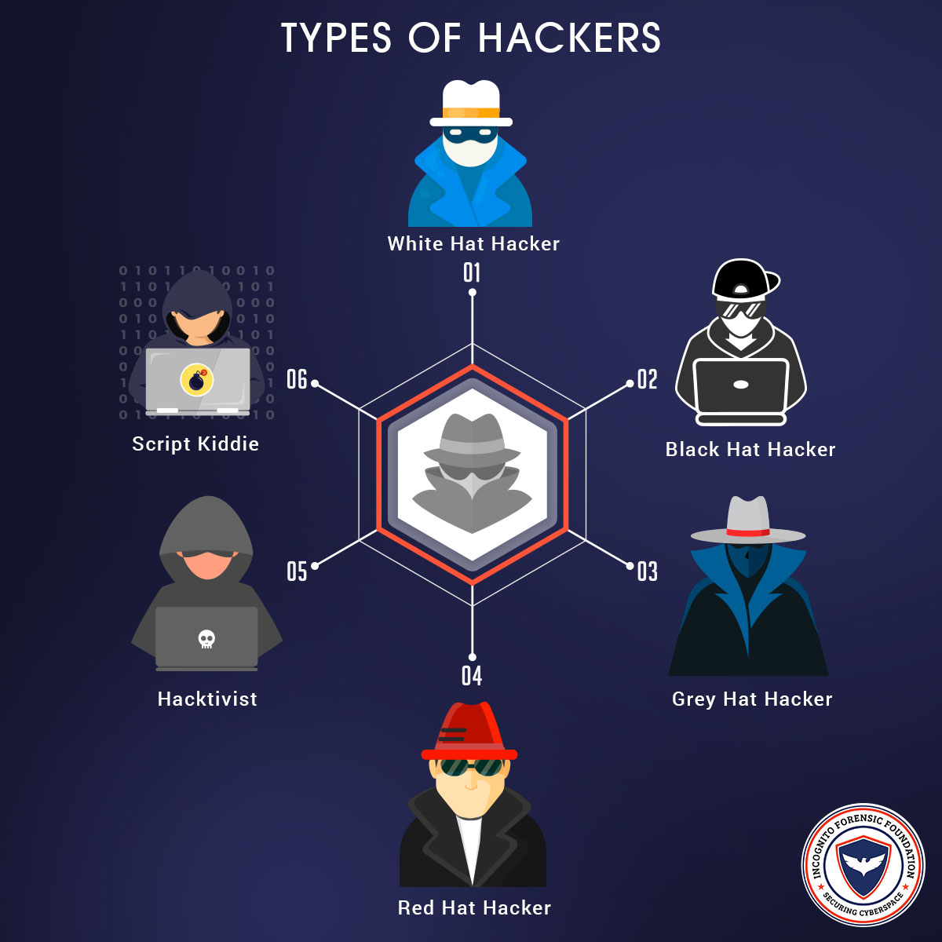
Types Of Hackers
Madhav Shah

Slide 5

Why Hacker Hacks?
• Vulnerability Scanning
Vulnerability scanning is a security technique employed for identifying security weaknesses in a computer system.
• Unauthorized Code Execution
Unauthorized Code Execution motives can be a bit complicated. Typically, hackers aim at infecting a user with malware.
• Monetary Loss
Online banking has become so popular and has been a revelation, however, the benefits definitely have their drawbacks.
Madhav Shah

Slide 6

how to protect your self from getting hacked
Use Multi-Factor Authentication
Get a Password Manager
Learn How to Spot a Phishing Attack
Use VPN(Virtual Private Network)
Update Everything
Encrypt Everything
Use TOR
Madhav Shah

Slide 7
Conclusion
Keep your password protected by using special character number uppercase lowercase etc.
Do not respond to phishing email.
When you are doing online transaction always keep watch on site whether protocol of site is https and whether there is lock symbol.
Be aware... Connect with care.
Madhav Shah

Slide 8
Thank you
Madhav Shah

